Slide 1
Data Insights Report
Example Association

Slide 2
Report Overview
In this report, you will find insights and recommendations that Tasio has uncovered from your association membership data. While none of this report constitutes legal or financial advice, it is designed to give you a better understanding of your members and a clear pathway for engaging with them in a more effective way.
Table of Contents
Retention Factors . . . . . . . . . . . . . . . . . . Page 3
Segmentation . . . . . . . . . . . . . . . . . . . . . Page 6
Next Steps . . . . . . . . . . . . . . . . . . . . . . . . Page 8
Your Organization Data Insights Report – Page 2

Slide 3
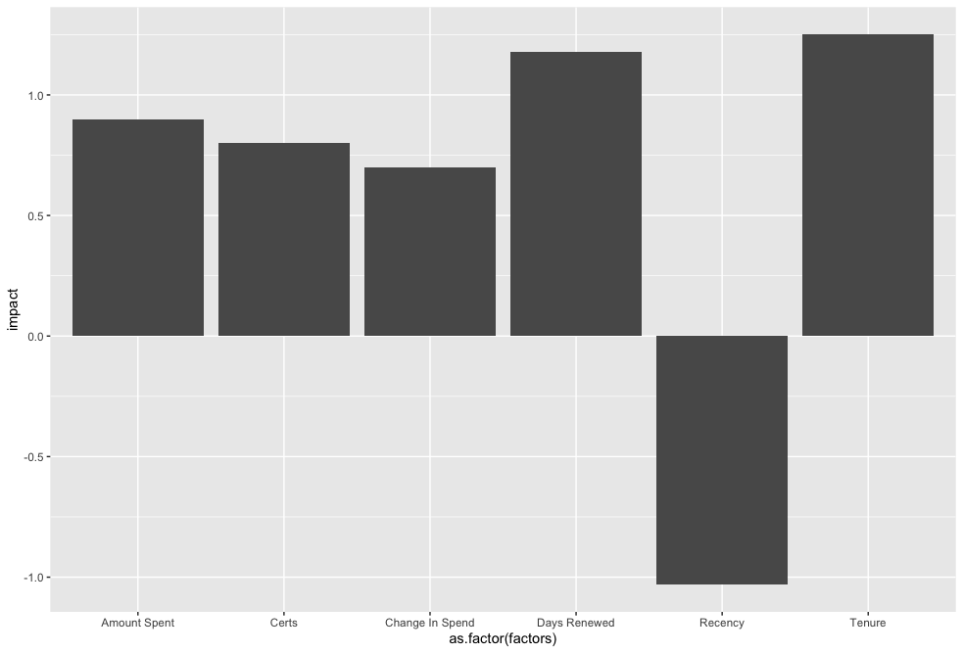
Retention Factors - Impact
Top Factors and the effect they have on renewal likelihood
Tasio’s analysis identified 31 discrete predictive factors for retention. The most impactful factors are below.
Your Organization Data Insights Report – Page 3

Slide 4
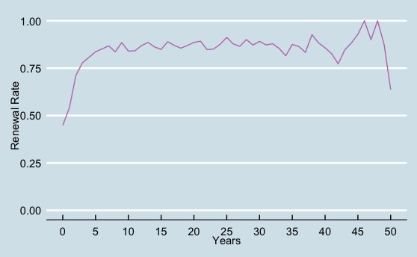
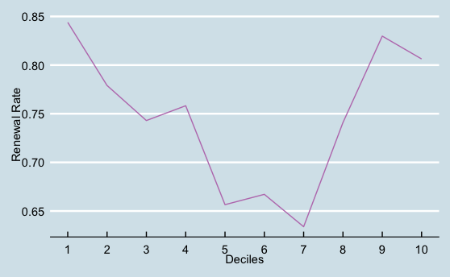
Retention Factors
Tenure of Membership
Days Since Last Purchase
The standard life cycle for members in your organization is roughly 5.5 years, with the most engaged period being year after 3 years. As initial membership falls into the past, the likelihood of non-renewing increases.
Days since last purchase showed a ”U-shaped” relationship to member retention. This pattern is common when an organization has a cohort of members that buy seasonally around the time of membership expiration, and don’t interact much during the intervening months.
Your Organization Data Insights Report – Page 4

Slide 5
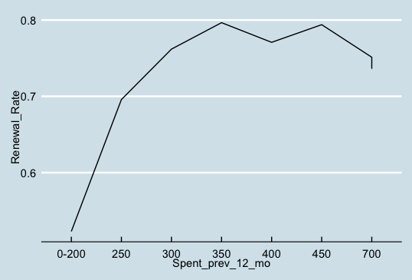
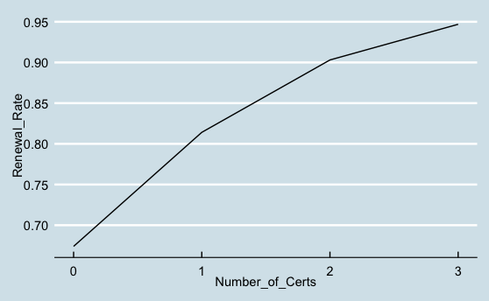
Retention Factors
Total $ Spent in the Previous 12 Mos
Number of Certificates
Members of Your Organization that are more likely to remain with the association tend to have spent greater than $300 in the previous 12 months. After $300 dollars no significant increase in renewal likelihood is seen.
A trend we noticed was that members are more likely to renew given the number of certificates they currently have. Members that have all 3 possible certificates are almost guaranteed to renew membership.
Your Organization Data Insights Report – Page 3

Slide 6
Segmentation
The People that Make Up Your Association.
In the next section, we’ll define the different segments of your association based on actions, habits, attitudes, and other demographic markers. Your association membership can be broken down into four key segments.
Active & Excited
Upwardly Mobile
Leadership-Bound
Ready for Change
These members are within their first 18 months of membership and frequently attend webinars.
These members are who have more than 3 years of membership and have recently received their first certificate.
These members who have more than 7 years of membership, have 2 certificates and have recently purchased the specifications document.
These members have less than 5 years of membership, attended a webinar the previous year but not this year.
Your Organization Data Insights Report – Page 5

Slide 7
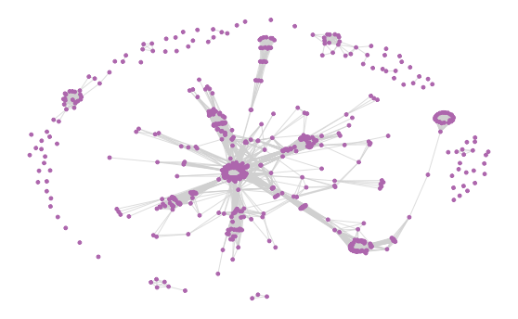
Community Map
Revealed Interested by Purchase Behavior
This map groups members by common purchases of the previous 5 years. Each dot on this map represents a member. Each line connects two members with very similar purchasing behaviors. The clusters represent members that behave similarly in purchasing behavior.
The “Hub and Spoke” layout seen with Your Organization’s data is common in organizations that have a core group of members that only purchase memberships and nothing else. The spokes represent members that buy membership and discrete set of products in common.
Your Organization Data Insights Report – Page 3

Slide 8
Next Steps for Your Organization
Personalized email to Upwardly Mobile with retention score between 40% - 60%. Objective is to increase retention rate in this segment.
Email Outreach to Persuadables
Call to Low Likelihood
Make a phone call to members with a retention score < 20%. Obejctive is to understand lack of engagement and short-comings
Enlist Advocates
Email Active & Excited
Your Organization Data Insights Report – Page 12

